Slide 1





AFWS
ADVANCE FLOOD WARNING SYSTEM
#Keep it Simple
Team Name : LoRa SYNC
PS no.-LN379
Smart India Hackathon

Slide 2

ARMY INSTITUTE OF TECHNOLOGY
PUNE
Team Members
Gaurav Mishra- Team Leader (Data Processing)
S Hussain Ali (Research, Testing)
Niharika Tapkir (Embedded)
Shubhangini Pandey (Dashboard)
Vivek Singh (Communication, Research)
Yaman Deep Singh (Communication, Testing)

Slide 3
PROBLEM STATEMENT
We are looking for advance Public address and Flood Warning Systems across all Hydro Power project areas. IoT sensors can be used for generating advance flood warning across hydro power project areas. IoT sensors data can be used with Public Address system to generate alarm.
Development of IoT Based advance Based And Flood warnings System across all Hydro Power Projects areas

Slide 4
Will be discussing…
1
What we have build?
2
Features of our solution
3
Use of technology (How we build it?)
4
Impact
5
Execution and deployment
6
Demonstration
7
Future Scope
8
Strengths

Slide 5
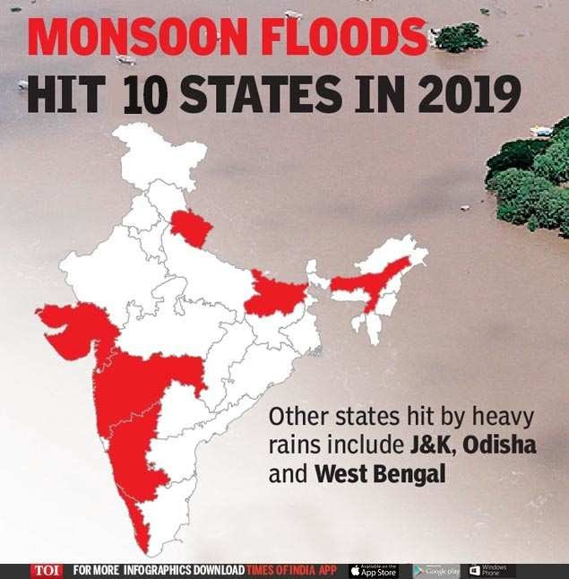
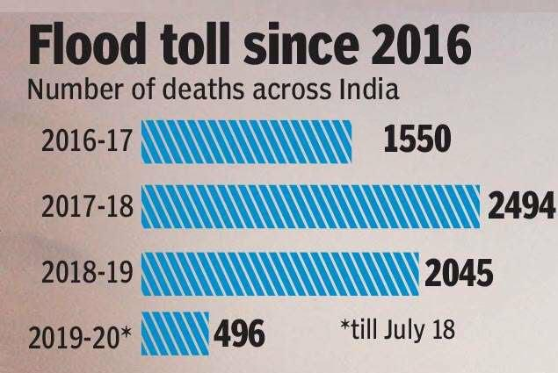
WHAT WE HAVE BUILT?
A system to give advance warning of flood to the
people in flood affected areas.

Slide 6




FEATURES OF OUR SOLUTION
EMBEDDED
DEVICE TO MEASURE THE WATER LEVEL
DASHBOARD
SMS
SIREN

Slide 7
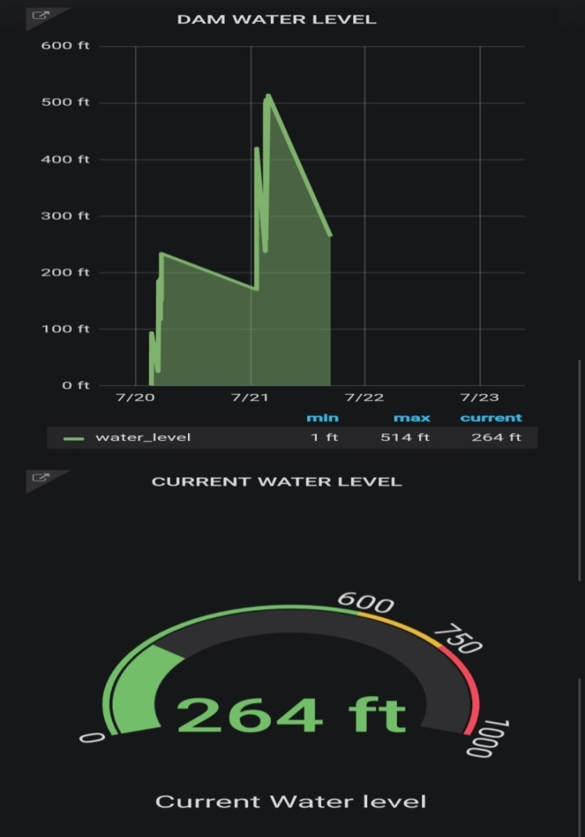
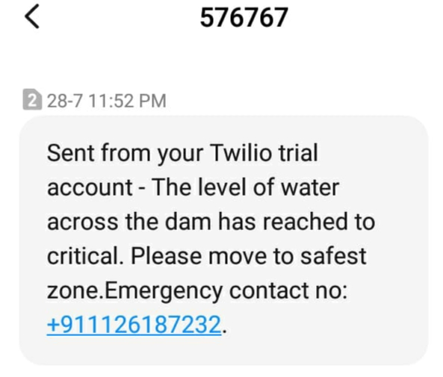
DASHBOARD
SMS
Please send forces for evacuation at XyZ at XX:XX IST.

Slide 8







HOW WE BUILT IT?
Hardware
Esp8266 wifi-module
Ultrasonic Sensor
Software

Slide 9



PROTOTYPE
MIDDLE LAYER
 | NODE RED DATA BASE TWILIO
.
.
PHYSICAL LAYER
 | SENSORS ESP MODULE LoRaWAN
APPLICATION LAYER
 | SMS SIREN GRAFANA

Slide 10




DATA DETECTION
(Physical layer)
ESP MODULE1
SENSOR
MQTT
Ultrasonic sensor to measure the
real-time water level of the dam.
The data is fetched by the Esp Wi-Fi module (slave1)
Provides channel for the Wi-Fi slave1 module and master module
Channels the data from master module to the next layer.

Slide 11

DATA PROCESSING AND VISUALIZATION
(Middle layer)
NODE RED
DATA BASE
TWILIO
To receive, analyze and process the data.
Data is stored in MySQL database.
Twilio provides SMS services.

Slide 12

USER INTERFACE
(Application layer)
SMS
SIREN
GRAFANA
An “ALERT” SMS is given to the user.
During critical situation siren is turned on.
Helpful in visualizing data.

Slide 13
Advance alert to people near dams.
Reduction in loss of lives (of people, cattle etc).
Graphs will give information about in which area, how frequently and in which season flood occurs.
IMPACT
Advance and accurate real time information about water level.
Prior to upcoming disaster we can run disaster management program.

Slide 14
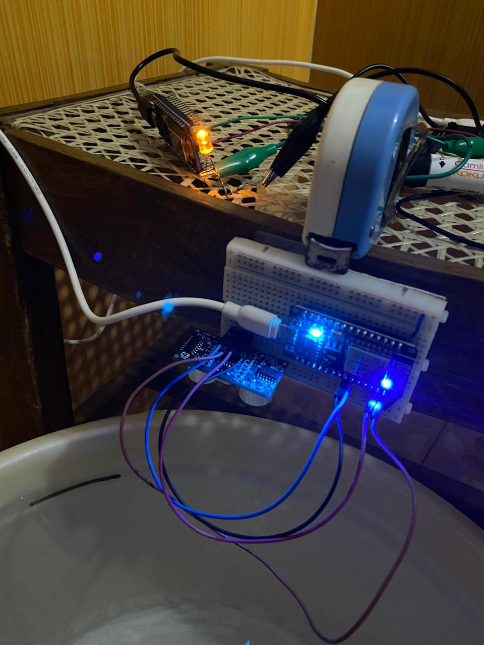
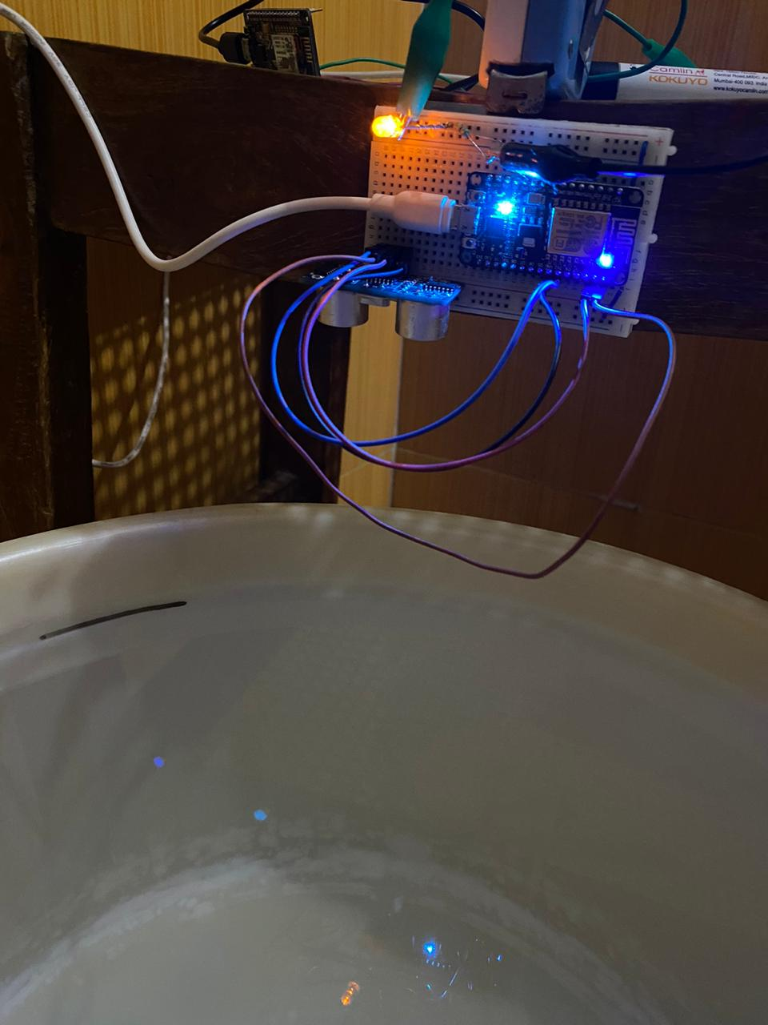
EXECUTION AND DEPLOYMENT

Slide 15
FUTURE SCOPE
Use of SARAL (ISRO Satellite).
Use of Geo-fencing.
Use of heat Signature.
Mobile application.

Slide 16
OUR STRENGTHS
Hardware
+
Software
Usage of industry tools
AWS based cloud system
Federated architecture
Simple design

Slide 17
THANKYOU

